Slide 1
OBJECT DETECTION
USING OPENCV
-by
D.Ram prasad
-Supervision by
Dr.AFREEN BANU
192225088

Slide 2
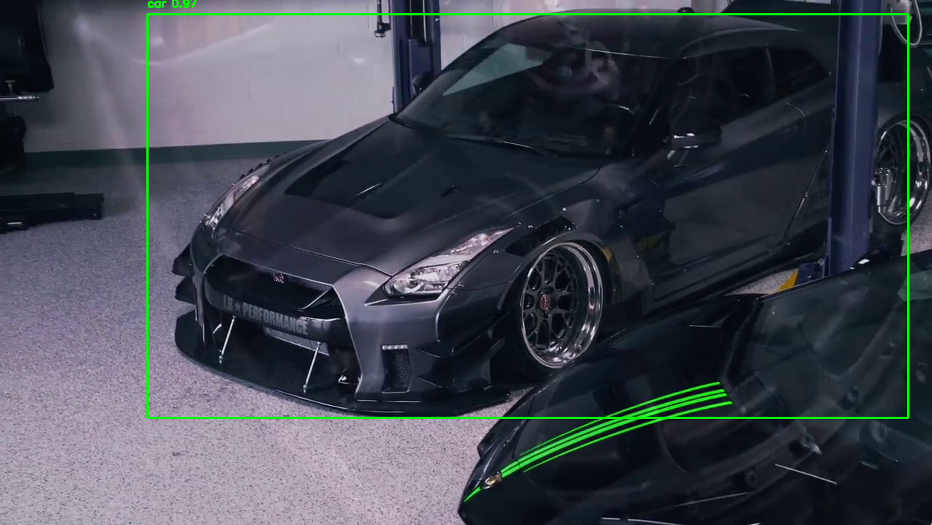
OBJECTIVE
Classify object type
Locate and identify objects
Achieve high accuracy
Ensure real-time performance
Applications

Slide 3
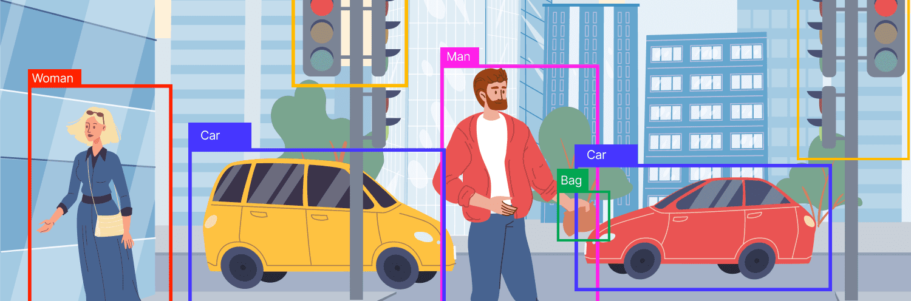
This is the core objective, aiming to find specific objects within an image or video frame.

Slide 4
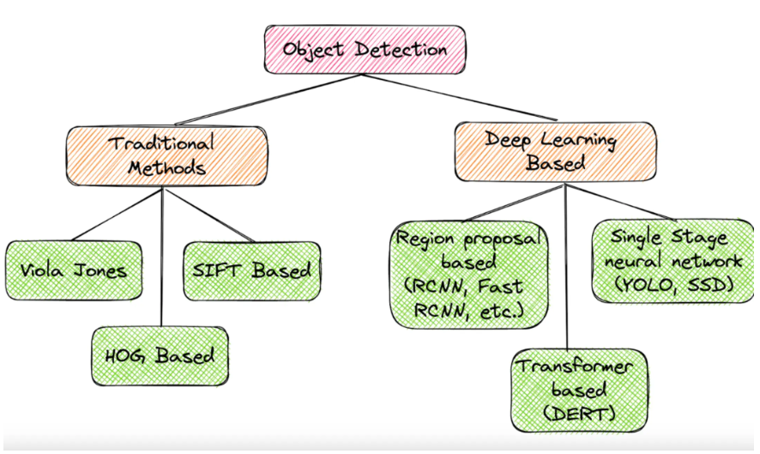

Slide 5
MACHINE LEARNING VS DEEP LEARNING
Machine Learning in Computer Vision:
Methodology: Relies on statistical models and algorithms for image analysis.
Feature Extraction: Requires manual feature engineering for pattern recognition.
Complexity: Limited complexity in handling intricate image structures and patterns.
Applications: Suitable for simpler tasks like basic image recognition and classification.
Deep Learning in Computer Vision:
Methodology: Utilizes deep neural networks for end-to-end image understanding.
Feature Extraction: Automatically learns complex features, reducing the need for manual engineering.
Complexity: Handles intricate patterns and hierarchical representations, excelling in complex tasks.
Applications: Powerful for advanced tasks such as object detection, segmentation, and image generation.

Slide 6
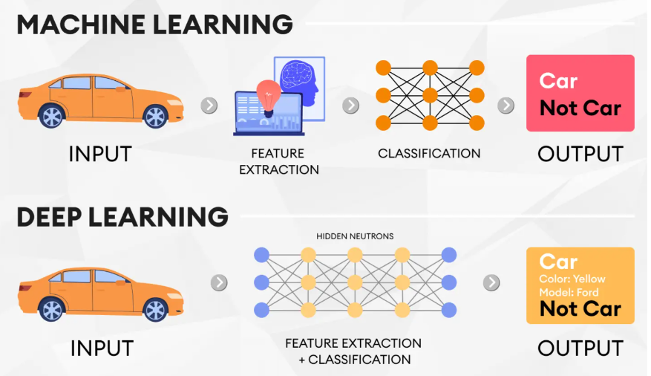

Slide 7
YOLO ALGORITHM
1. Efficient Processing: YOLO achieves real-time object detection through single-pass efficiency.
2. Grid Simplification: YOLO's grid structure streamlines systematic object detection across images.
3. Multi-Class Capability: YOLO excels in simultaneous identification and classification of multiple object classes.
4. Anchor Box Precision: YOLO's anchor boxes enhance accuracy for varying object sizes and shapes.

Slide 8
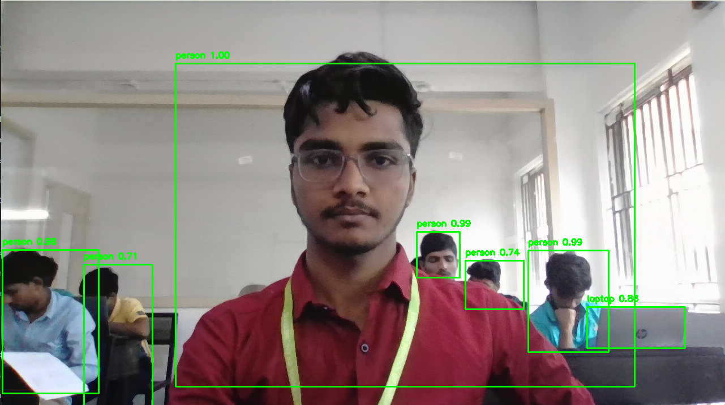
Applications
Surveillance, security, and traffic
Automobile
Medical
Retail
Facial Recognition
Environmental Monitoring
Sports Analytics
Agriculture
Fire Detection

Slide 9
IMPLEMENTATION CODE :
import cv2
import numpy as np
# Load YOLO
net = cv2.dnn.readNet("C:\computer vision project\yolov3.weights", "C:\computer vision project\yolov3.cfg")
layer_names = net.getLayerNames()
output_layers = [layer_names[i - 1] for i in net.getUnconnectedOutLayers()]
# Load classes
classes = []
with open("C:\computer vision project\coco.names", "r") as f:
classes = [line.strip() for line in f.readlines()]
# Open video capture
cap = cv2.VideoCapture(0) # Replace with the path to your video file
while cap.isOpened():
ret, frame = cap.read()
if not ret:
break
height, width, channels = frame.shape
# Preprocess image
blob = cv2.dnn.blobFromImage(frame, 0.00392, (416, 416), (0, 0, 0), True, crop=False)
net.setInput(blob)
outs = net.forward(output_layers)
# Get information about detected objects
class_ids = []
confidences = []
boxes = []
for out in outs:
for detection in out:
scores = detection[5:]
class_id = np.argmax(scores)
confidence = scores[class_id]
if confidence > 0.5: # Adjust confidence threshold as needed
# Object detected
center_x = int(detection[0] * width)
center_y = int(detection[1] * height)
w = int(detection[2] * width)
h = int(detection[3] * height)
# Rectangle coordinates
x = int(center_x - w / 2)
y = int(center_y - h / 2)
boxes.append([x, y, w, h])
confidences.append(float(confidence))
class_ids.append(class_id)
# Non-maximum suppression to eliminate redundant overlapping boxes
indexes = cv2.dnn.NMSBoxes(boxes, confidences, 0.5, 0.4)
# Draw bounding boxes
for i in range(len(boxes)):
if i in indexes:
x, y, w, h = boxes[i]
label = classes[class_ids[i]]
confidence = confidences[i]
color = (0, 255, 0) # You can change the color as needed
cv2.rectangle(frame, (x, y), (x + w, y + h), color, 2)
cv2.putText(frame, f"{label} {confidence:.2f}", (x, y - 10), cv2.FONT_HERSHEY_SIMPLEX, 0.5, color, 2)
# Display the result
cv2.imshow("Object Detection", frame)
if cv2.waitKey(1) & 0xFF == ord('q'):
break
# Release video capture and close windows
cap.release()
cv2.destroyAllWindows()

Slide 10
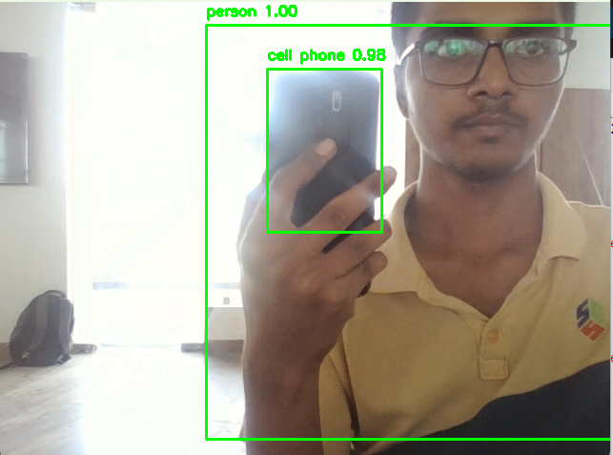
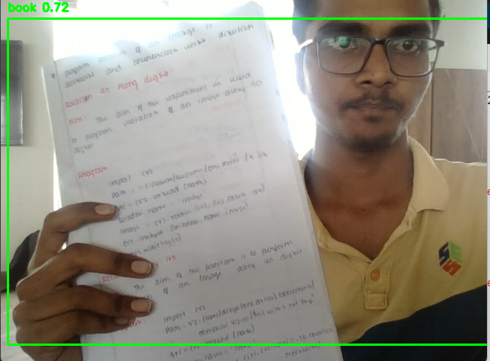
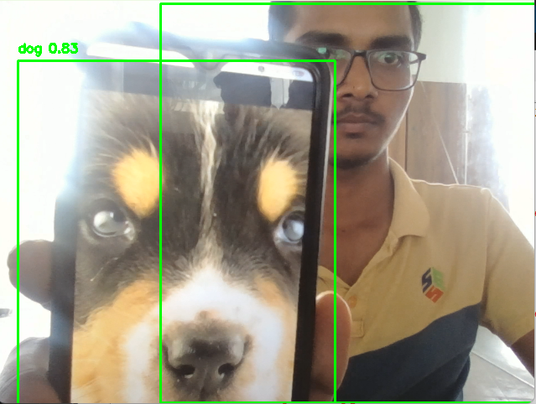

Slide 11
THANK YOU

